Slide 1


Summer Internship (Fitness Area : Gym Website)
Accredited with Grade A+ by NAAC Accredited with Grade A by KCG
Neel Thomas(20CS095)
Guided By : Prof. Vidisha Pradhan

Slide 2
Agenda
The agenda of this summer internship was to gain experience from the work that I had done under some of the experienced employees and heads of the company. This experience will help me while interning or working as a permanent employee in a company in near future. As an intern I also learnt about the attitude that I should have while working in a company.

Slide 3
Definition of Project
I was assigned to create a website for a gym which will have contact details that would be just a click away and also which would contain registration page for those who want to register from their home and cant physically go to the place and register their name.

Slide 4
Technology Description
Technology used for the development of the website was Visual Studio Code commonly referred as VS Code.
It is a source code editor made by Microsoft for Windows, MacOS and Linux.
Features include support for debugging, syntax highlighting, intelligent code completion, snippets, code refactoring and embedded Git.
The languages used were HTML, CSS and PHP.

Slide 5
Technology Description
HTML
HTML (HyperText Markup Language) is the most basic building block of the Web. It defines the meaning and structure of web content. Other technologies besides HTML are generally used to describe a web page's appearance/presentation (CSS) or functionality/behavior (JavaScript).
"Hypertext" refers to links that connect web pages to one another, either within a single website or between websites. Links are a fundamental aspect of the Web. By uploading content to the Internet and linking it to pages created by other people, you become an active participant in the World Wide Web.

Slide 6
Technology Description
CSS
Cascading Style Sheets (CSS) is a stylesheet language used to describe the presentation of a document written in HTML or XML (including XML dialects such as SVG, MathML or XHTML). CSS describes how elements should be rendered on screen, on paper, in speech, or on other media.
CSS is among the core languages of the open web and is standardized across Web browsers according to W3C specifications. Previously, the development of various parts of CSS specification was done synchronously, which allowed the versioning of the latest recommendations. You might have heard about CSS1, CSS2.1, or even CSS3. There will never be a CSS3 or a CSS4; rather, everything is now CSS without a version number.

Slide 7
Technology Description
PHP
The term PHP is an acronym for Hypertext Preprocessor. It is a server-side scripting language that is used for web development. It can be easily embedded with HTML files. HTML codes can also be written in a PHP file. The PHP codes are executed on the server-side whereas HTML codes are directly executed on the browser.
PHP started out as a small open source project that evolved as more and more people found out how useful it was. Rasmus Lerdorf unleashed the first version of PHP way back in 1994.PHP is a MUST for students and working professionals to become a great Software Engineer specially when they are working in Web Development Domain.

Slide 8
Roles and Responsibilities
I was considered as a front end and backend developer. I acted as a tester as well as a debugger. The creation of the test and release application was done by the backend designer. The beautification and the increase in the user friendliness of the application was done by the frontend designer.

Slide 9
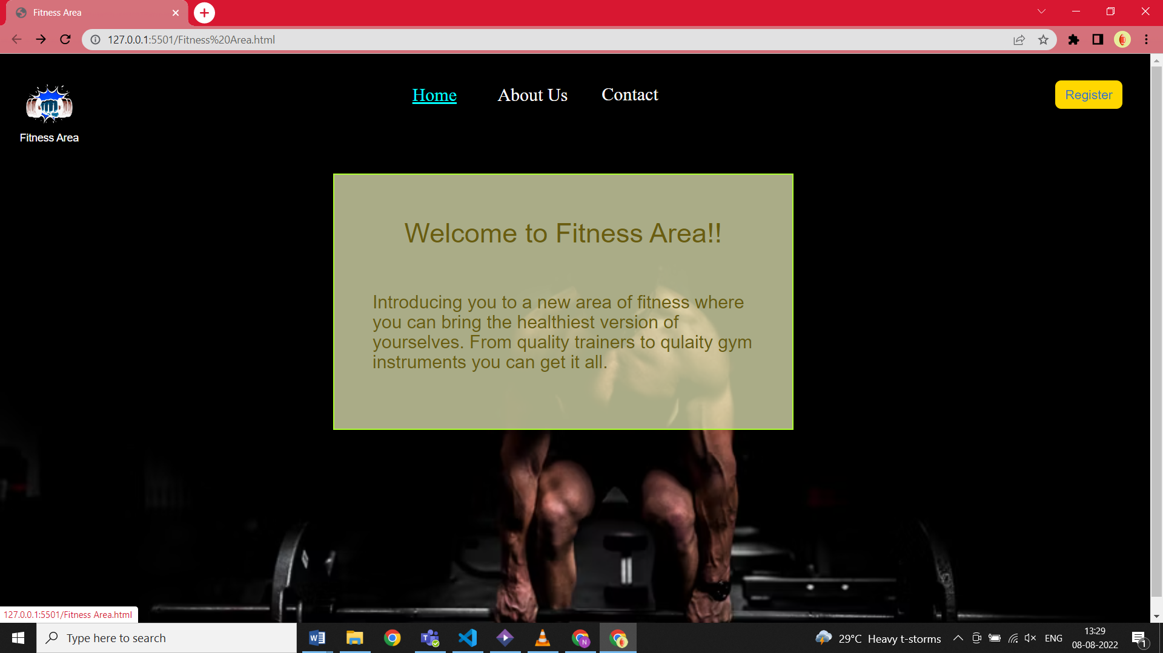
Screenshots of Work Done
Home Page

Slide 10
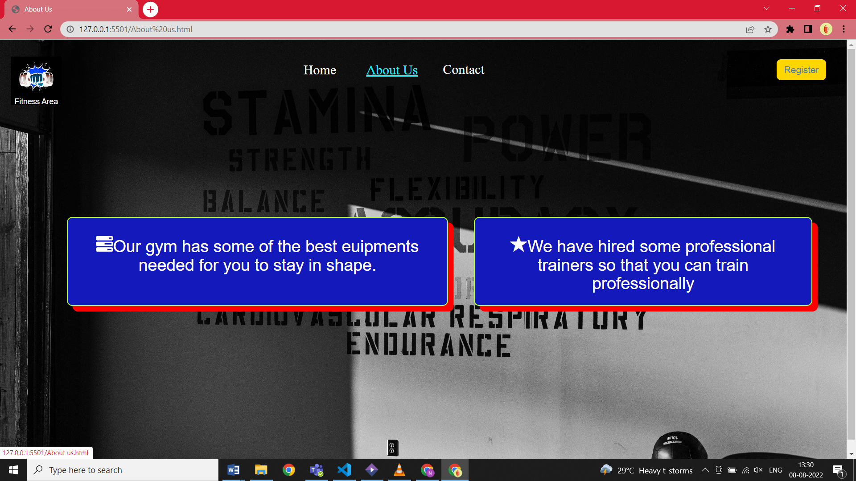
Screenshots of Work Done
About Us Page

Slide 11
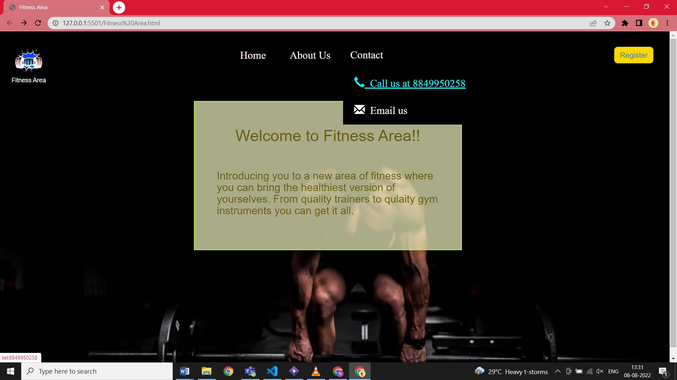
Screenshots of Work Done
Contact Details

Slide 12
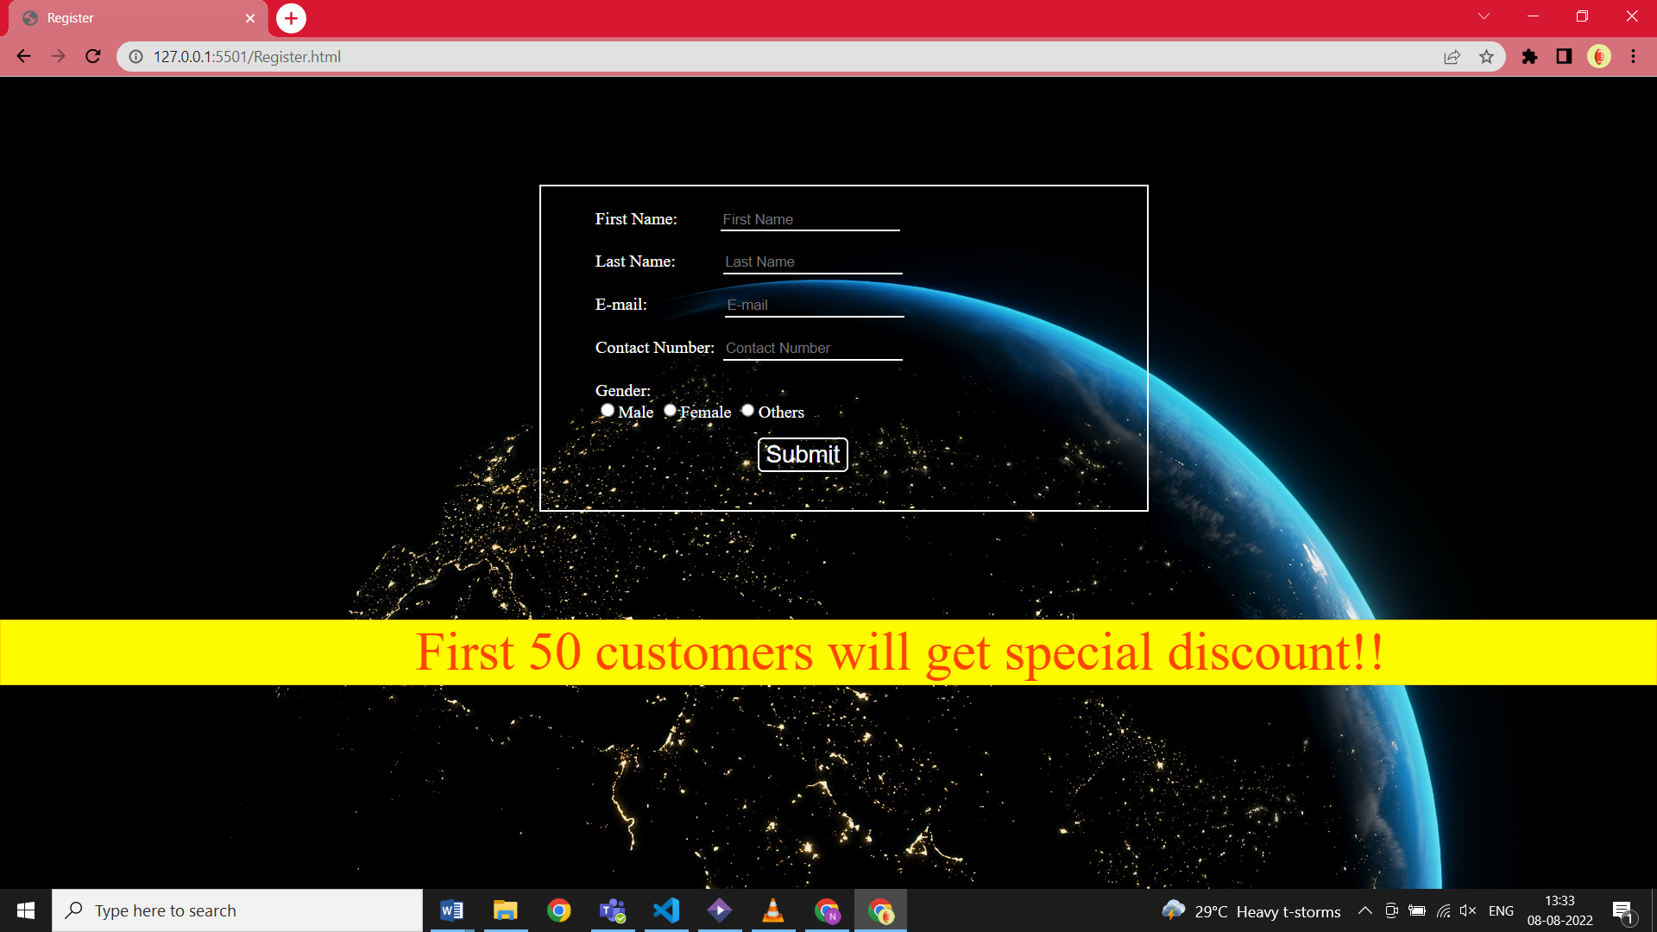
Screenshots of Work Done
Registration Page

Slide 13
Advantages of taking internship
First time internship with a company (Wiz Developers) for 6 weeks was an overwhelming yet educated experience. It gives an inside view of how the knowledge and skills which we learn in our classes are implemented for solving actual real-life problems for certain people.
This whole experience also shows us a glimpse of the aspect of life after we graduate and helps us to sharpen our skills to use them resourcefully.

Slide 14
Thank You

